Slide 1
Sales Performance & Profitability Analysis
Data Storytelling & Statistical Validation
Sanket Wali

Slide 2
Business Objective
Understand sales performance and profitability drivers
Identify high-performing regions and product categories
Analyze how discounts affect profits
Generate actionable recommendations for business growth

Slide 3
Dataset Overview
Dataset: Global Store Sales
Total Records: ~51K
Key Fields: Sales, Profit, Discount, Category, Segment, Region
Tools Used: Python, Pandas, Data Visualization, Statistical Testing

Slide 4
Key Performance Indicators
Total Sales Revenue
Total Profit Generated
Average Discount Applied
Average Order Value
Total Orders Processed

Slide 5
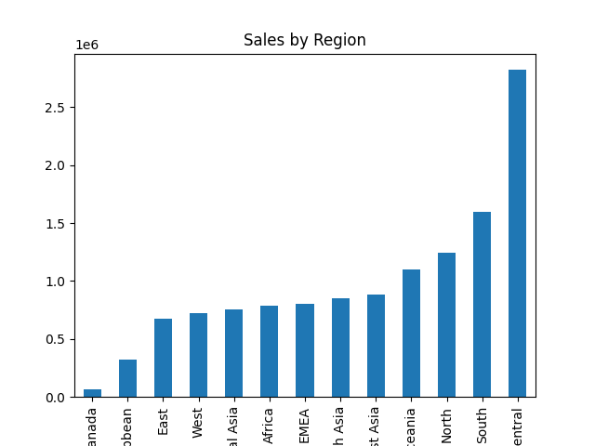
Regional Sales Analysis
Key Insight:
West and East regions contribute the highest revenue. Some regions show high sales but lower profit margins.

Slide 6
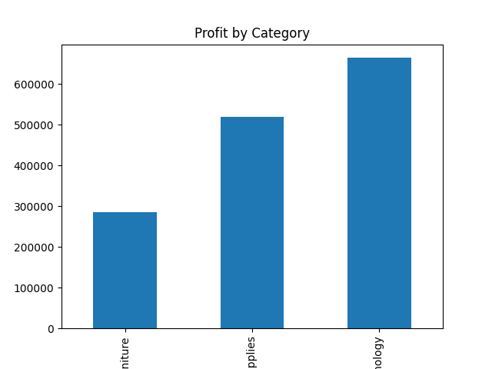
Category Profitability
Key Insight:
Technology category generates the highest profit while some categories depend heavily on discounting.

Slide 7
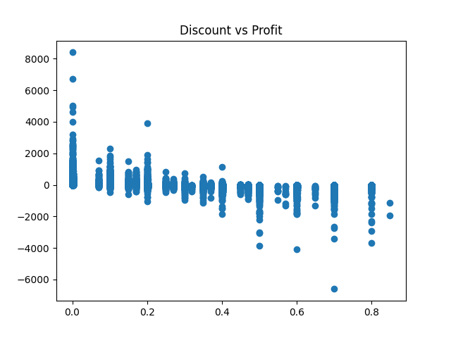
Discount vs Profit Relationship
Key Insight:
High discounts correlate with lower profits. Discounts above 20% frequently lead to negative margins.

Slide 8
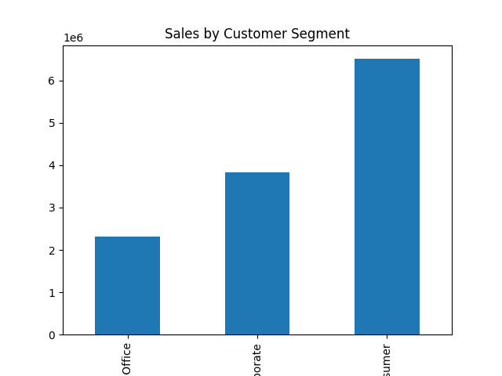
Customer Segment Insights
Key Insight:
Corporate customers generate higher value orders while consumer segment drives order volume.

Slide 9
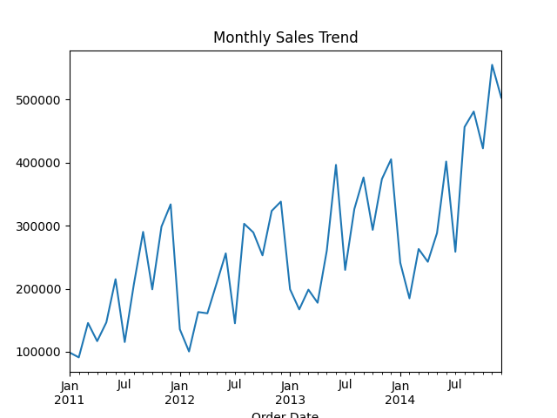
Sales Trend Over Time
Key Insight:
Sales fluctuate over time with noticeable seasonal peaks suggesting demand cycles.

Slide 10
Strategic Business Recommendations
Limit excessive discounting to protect margins
Invest more in high-profit categories like Technology
Investigate operational inefficiencies in low-profit regions
Develop loyalty programs for high-value corporate customers

